Slide 1
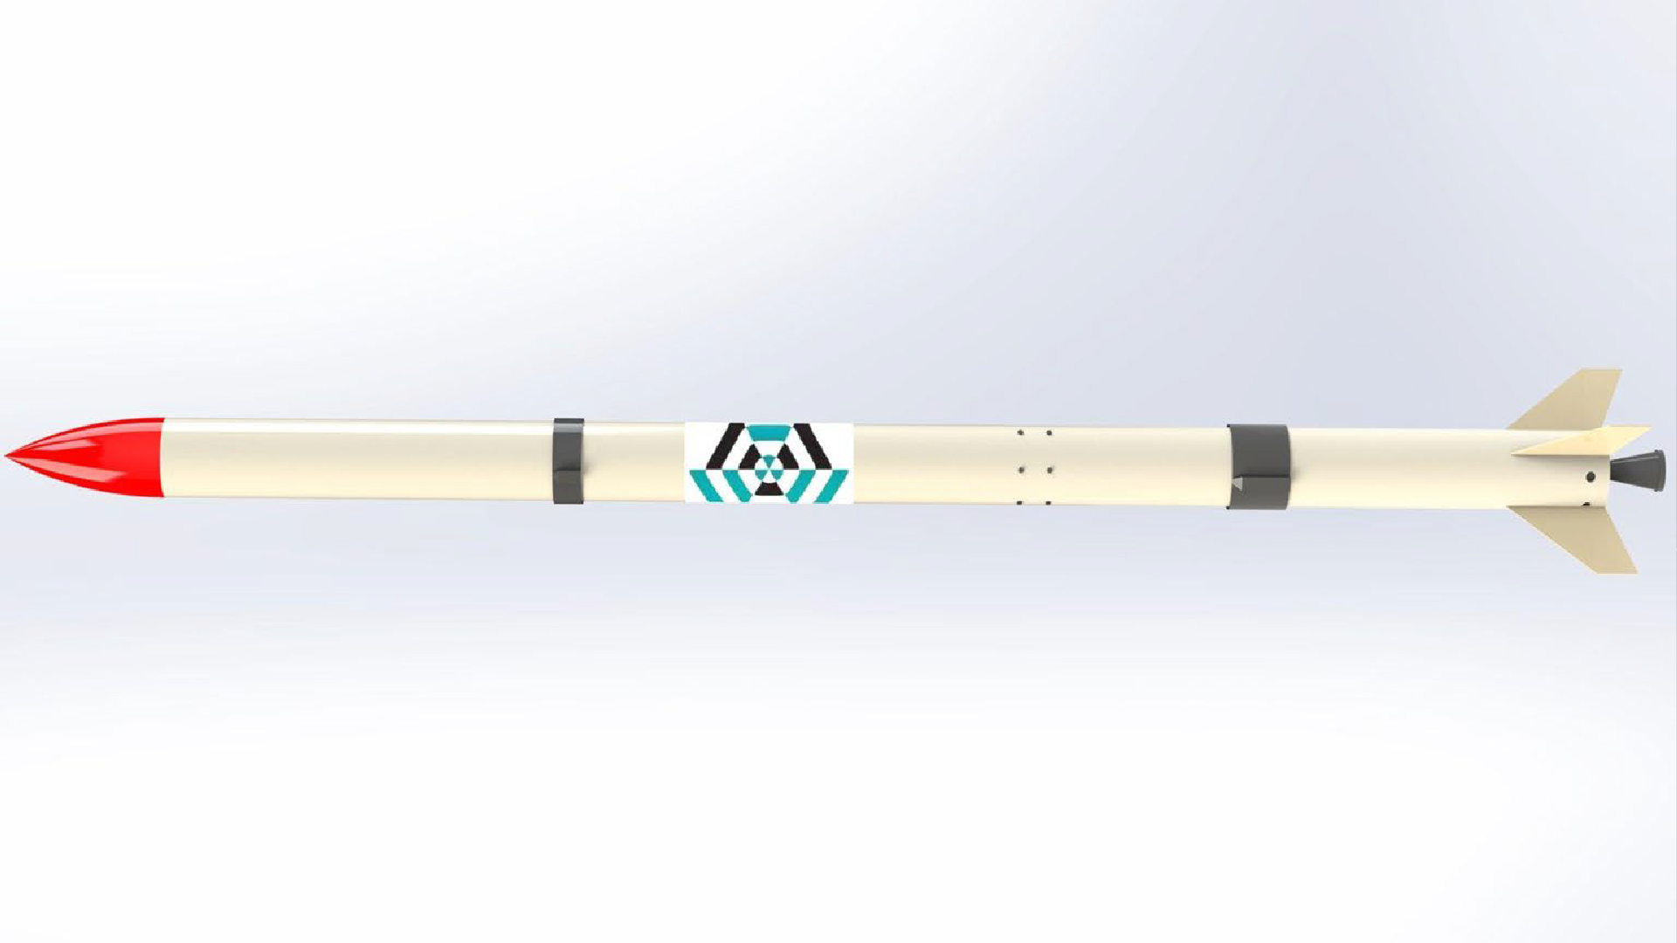
Airframe Progress Report
-19/5/2023-

Slide 2
Fabrication of the Launch pad.
Fabrication of the fin alignment jig.
parachute test
Nose cone 3D fabrication.
OVERVIEW

Slide 3
FABRICATION PROCESS
95% complete.
CHALLENGES
Time for issuing tools.
#20
Launchpad

Slide 4
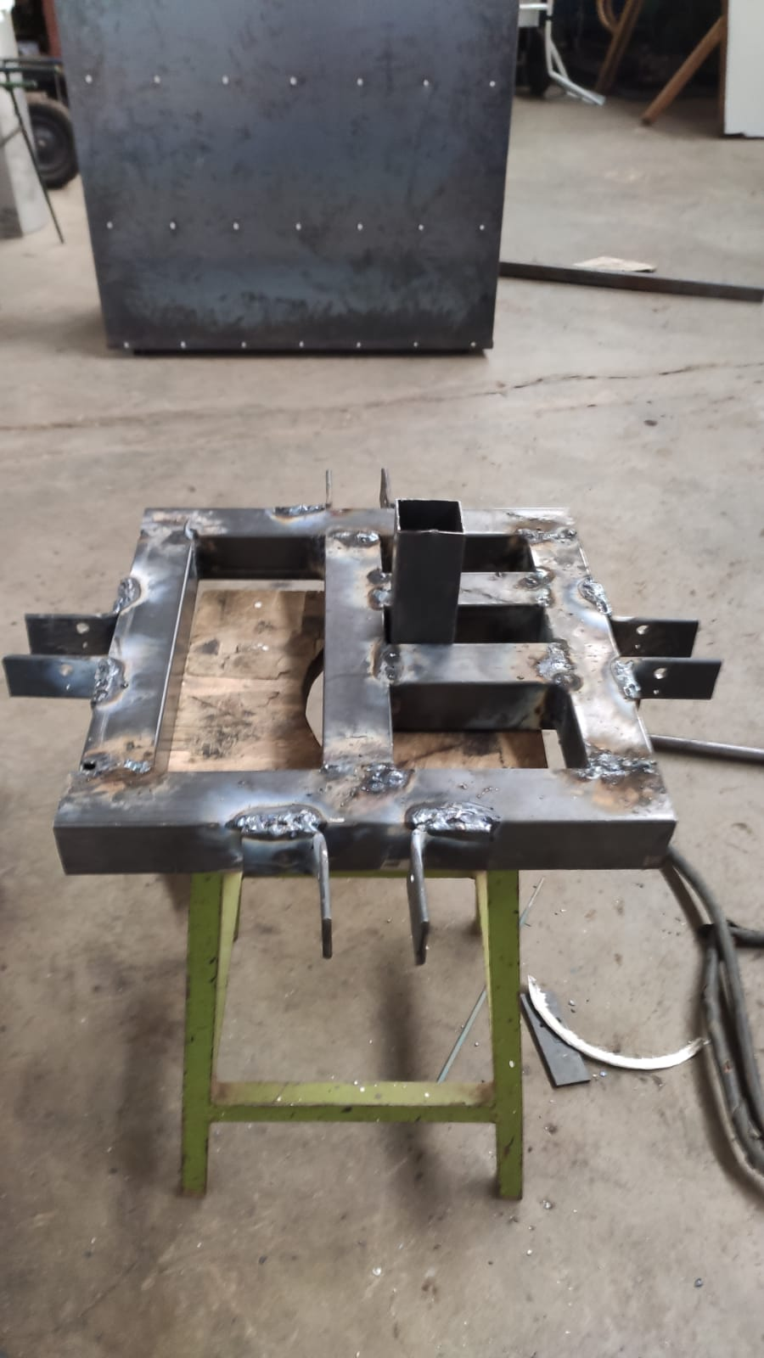
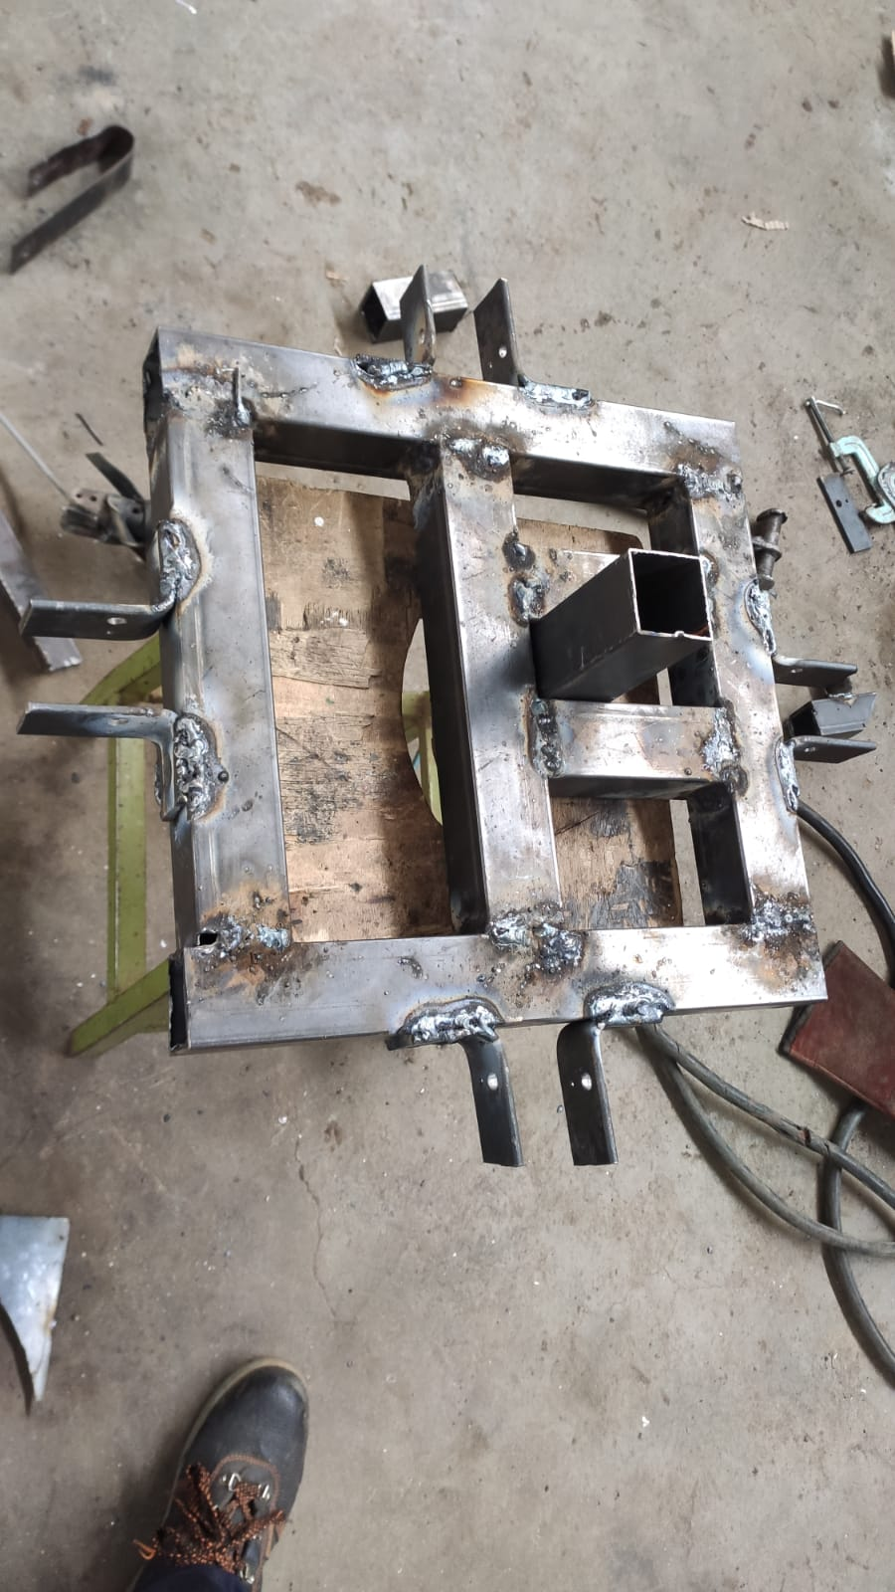
90% Complete

Slide 5
100% complete.
Fabrication of the fin alignment jig

Slide 6
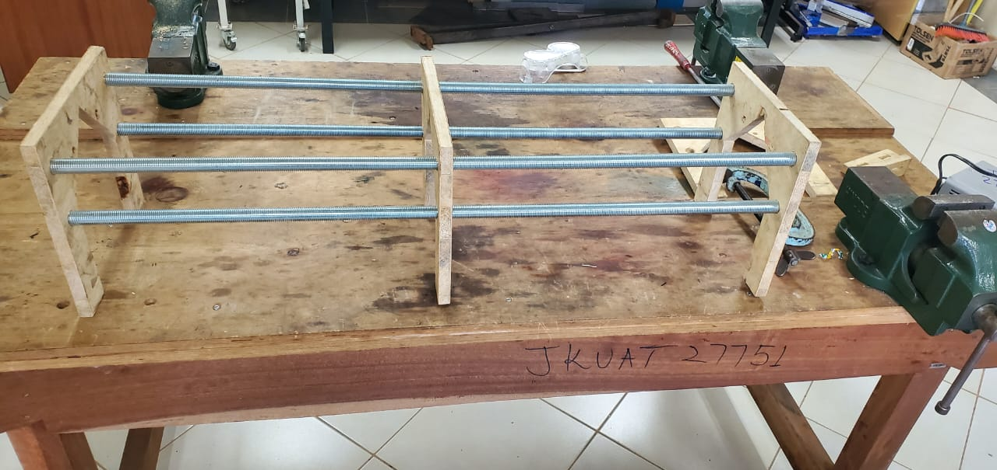
50% Jig Assembly

Slide 7
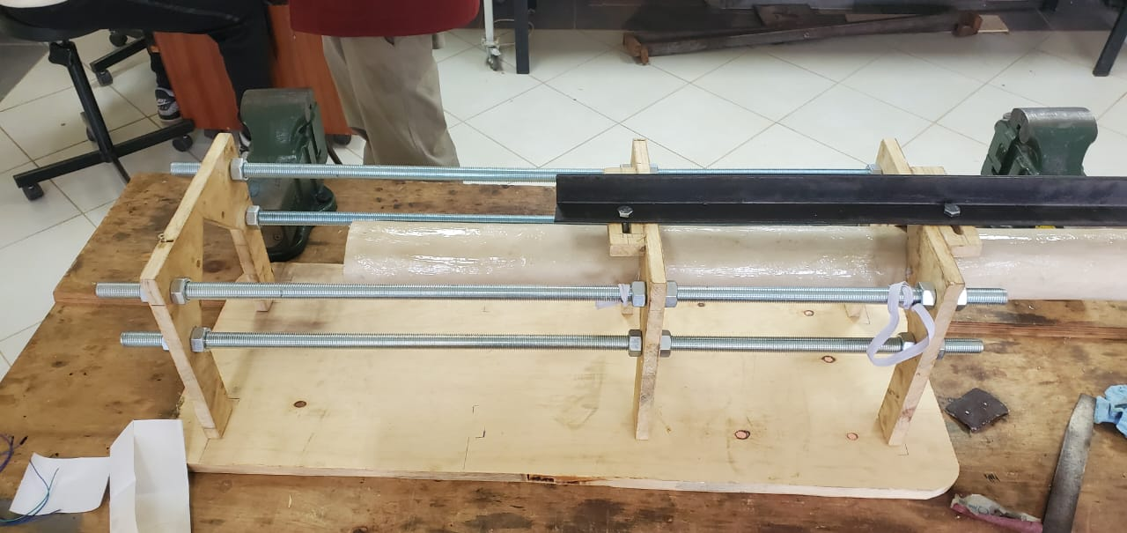
Complete jig Assembly

Slide 8
The fabricated parachutes were tested to determine their performance.
It was attached the to the back of a moving object (bike) to simulate its opening after ejection.
Parachutes

Slide 9
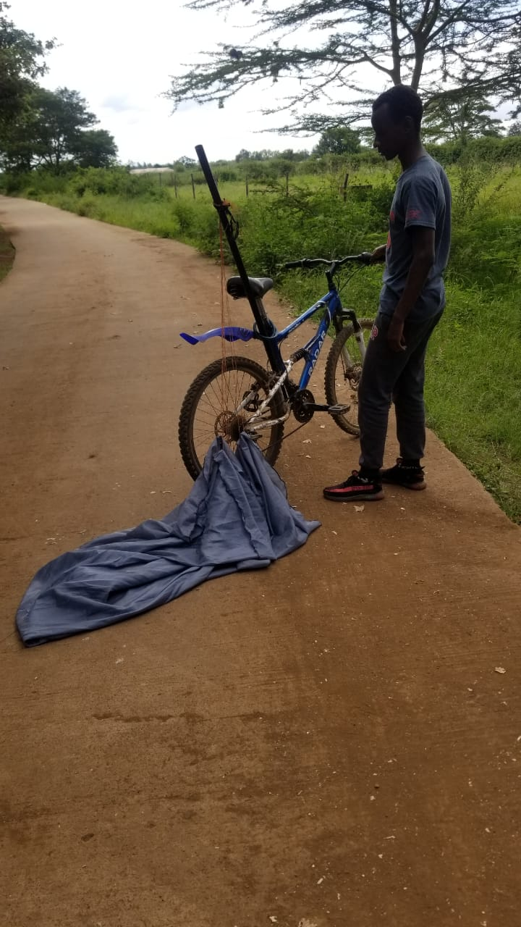
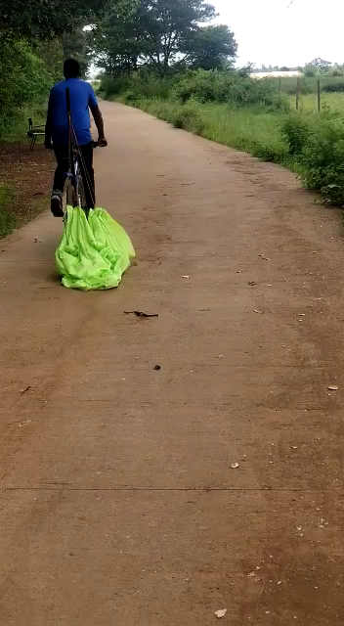
Testing

Slide 10
Results and Observations
All the parachutes managed to deploy.
The distance needed to deploy the parachute was determined by the amount of air trapped inside.
The presence of wind during certain tests affected the performance of the parachutes.
It is vital that the parachute be deployed in relatively calm conditions.
Way Forward
Decide on a mechanism that will hasten the opening during the drop test.

Slide 11
Parachute
FREE DROP TESTING
Intend to do a free-drop test from a high point and measure the rate of descent
CHALLENGE.
The predetermined test area had a parking lot base.

Slide 12
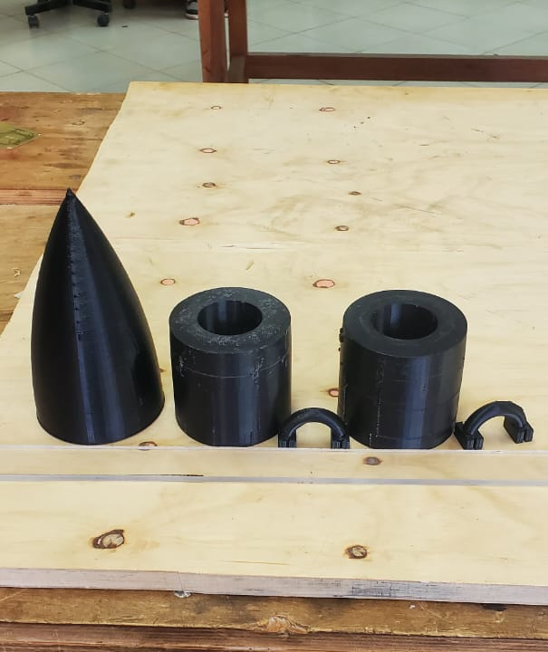
Nose cone 3D fabrication.
2 nose cones complete

Slide 13
NEXT WEEK’S
OBJECTIVES
Complete 3D printing of nose cones.
Designing of fin size
Fin Fabrication

Slide 14
THANKYOU
Q/A

